Slide 1



















Strengthening the Austrian Value Chain for Additive Manufacturing in industrial Production
„addmanu“
Project-Abstract
1
Notes:
^{JROEASENANREUCMH ,}
„
':,,t

Slide 2
Strategic Goals and Objectives of addmanu
Austrian flag ship project addmanu concentrates on industrial application of additive manufacturing
Scope on key topics „industrial production“ addressing the following issues:
New materials
New production processes
Application and production orientated design for additive manufactured parts
Novel application
Process integration und new business models
Strengthening of the Austrian industrial value chain by additive manufacturing
2

Slide 3
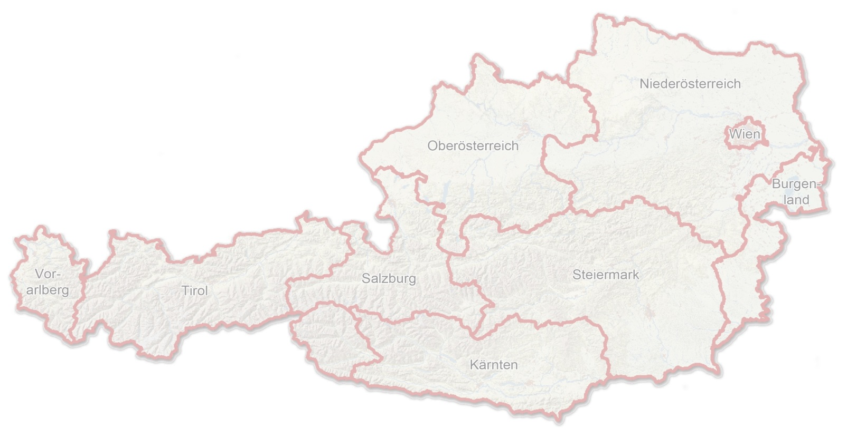
Consortium - Austrian and German Partner network
SME
Large Enterprises
Research Institutions
Market segments:
Materials/Surface Technology: Böhler Edelstahl, RHI, Tiger Lacke, CEST
Mechanical and Equipment Engineering: Hage Sondermaschinenbau, PKT Bürtlmair, Lithoz, O.K. + Partner
Electronic: LAM Research
(4) Automotive: Magna Steyr Engineering, Mahle Austria Filtersystem
(5) Aerospace: Airbus DS, RHP Technology
(6) Energy Technology: GE Jenbacher
(7) Science, Research and Training: Joanneum Research, FOTEC, Montanuniversitaet, Profactor, TU Wien, CEST
3

Slide 4
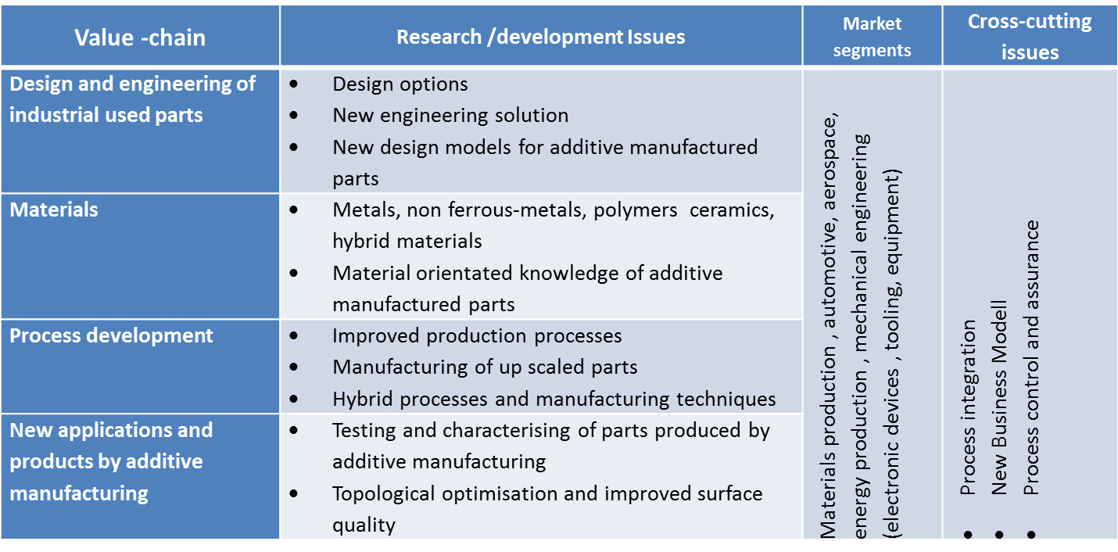
Concentration on additive manufacturing in industrial production– facing the following challenges
Project factsheet:
Start: Mai 2015
Budget: approx. 6 Mio €
Funding: approx. 3,8 Mio €
Project duration: 3years
Funding Agency: FFG, Program „Production of the future“
Co-ordination
Montanuniversitaet, Dr. Brigitte Kriszt
Scientific Lead
TU Wien, Prof. Dr. Jürgen Stampfl
Web: www. addmanu.at
4

